Slide 1


Lesson 9 The magic of films
UNIT 3

Slide 2
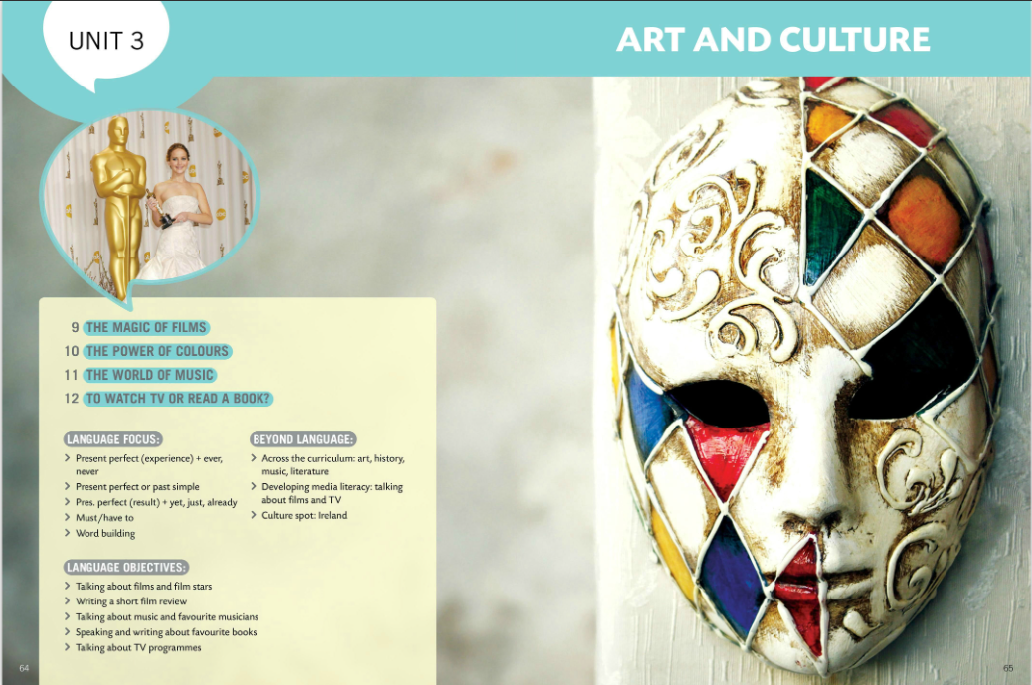
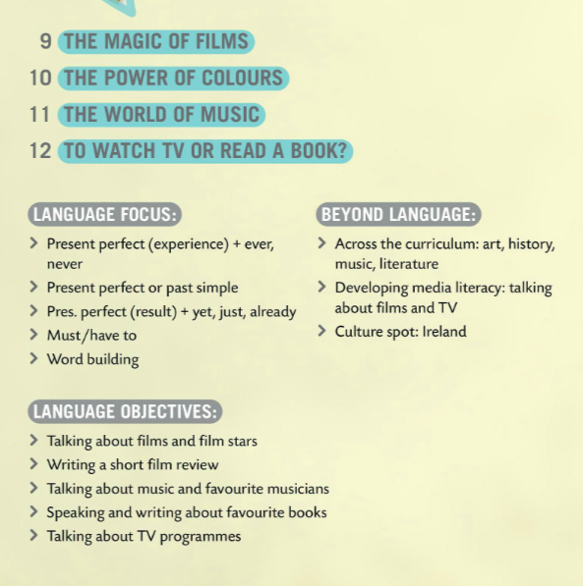
In this unit you will learn about

Slide 3



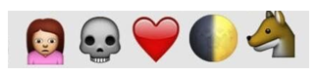

Guess the film
Divide into two teams. Guess the film and write down your answer on a piece of paper.
You win a point if you spell and pronounce the name of the film correctly.
MADAGASCAR
NIGHT AT THE MUSEUM
HARRY POTTER
TWILIGHT
LION KING

Slide 4
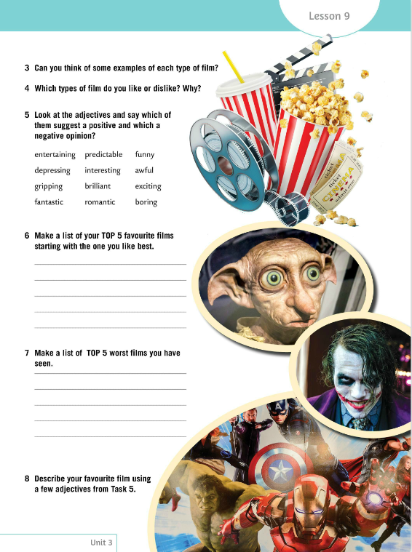
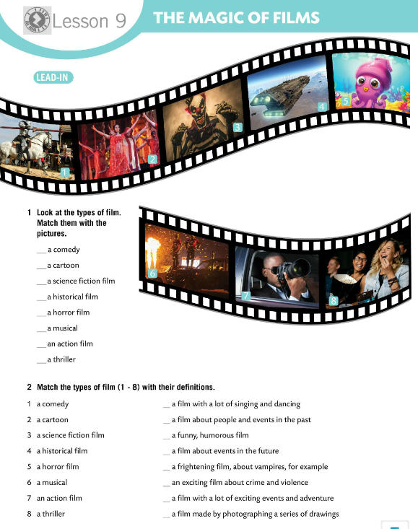
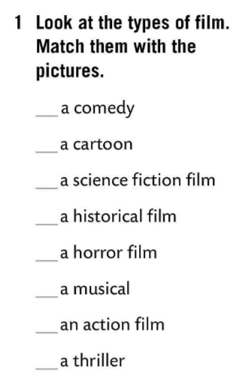
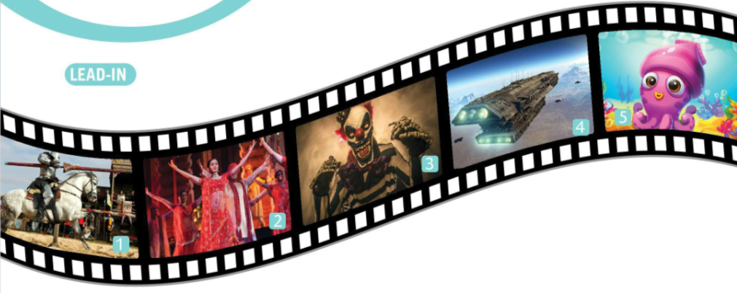
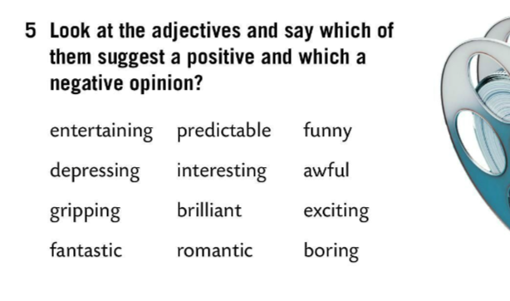
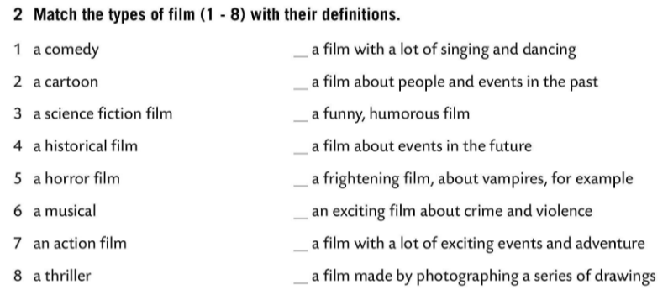
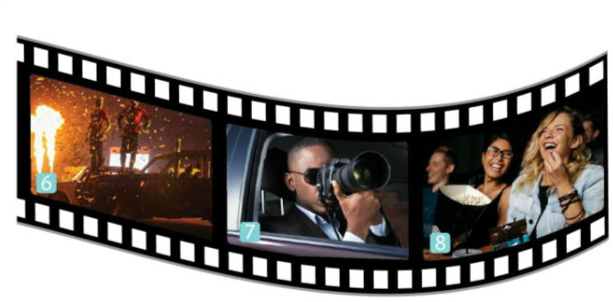
Look at the types of film. Match them with the pictures.
Check.
Match the types of film (1-8) with their definitions.
8
5
6
Check.
4
4
1
3
Can you think of some examples of each type of film?
1
5
3
8
7
Which types of film do you like or dislike? Why?
2
2
6
7
Look at the adjectives in Task 5 and say which of them suggest a positive and which a negative opinion.

Slide 5
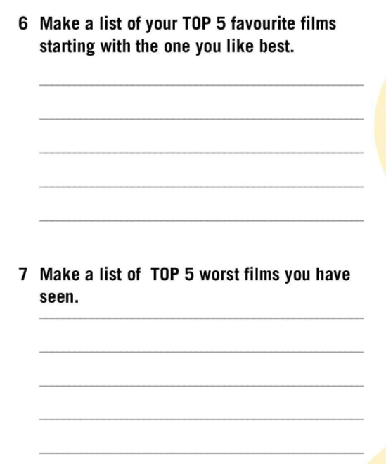

Make a list of your TOP 5 favourite films starting with the one you like best.
Make a list of TOP 5 worst films you have seen.

Slide 6
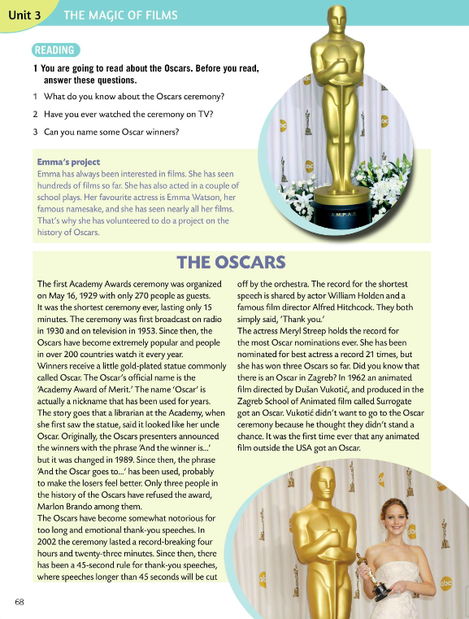
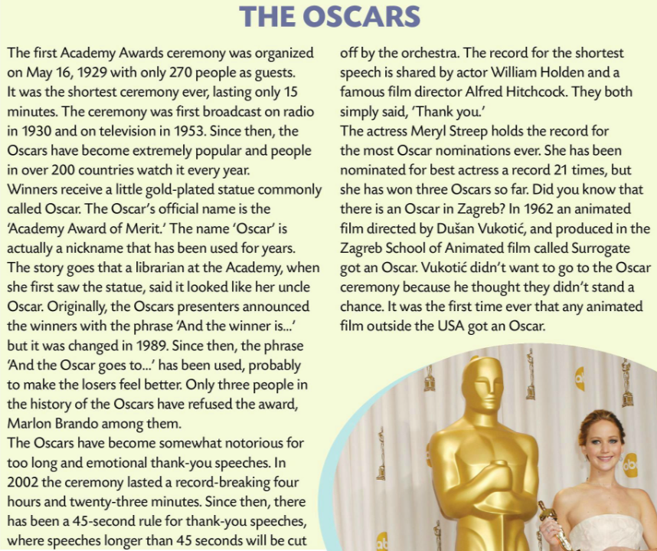
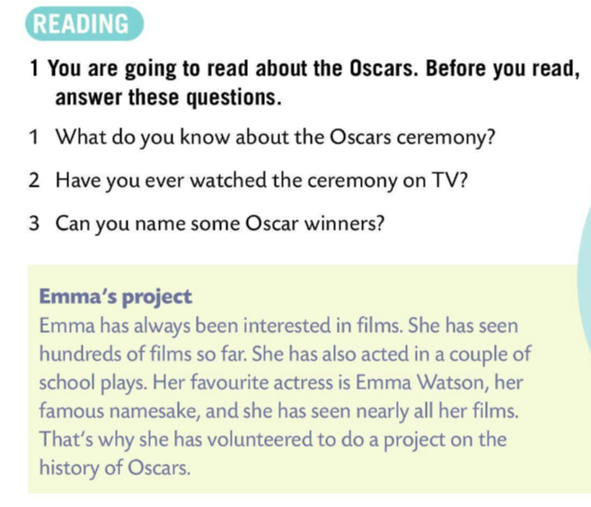
You are going to read about the Oscars. Before you read, answer these questions.
1 What do you know about the Oscars ceremony?
2 Have you ever watched the ceremony on TV?
3 Can you name some Oscar winners?
Read about Emma’s history project. Then read the text.

Slide 7
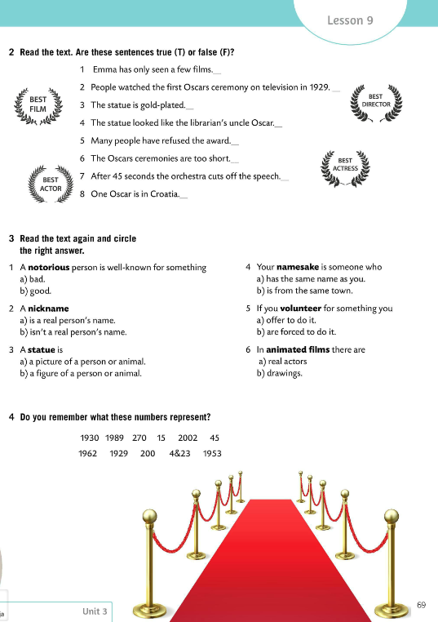
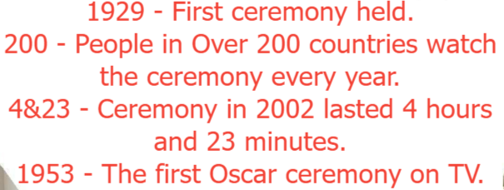
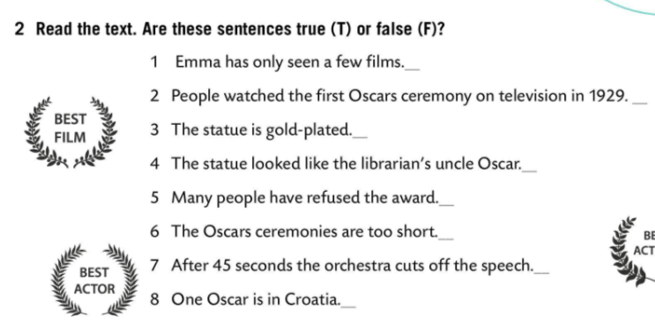
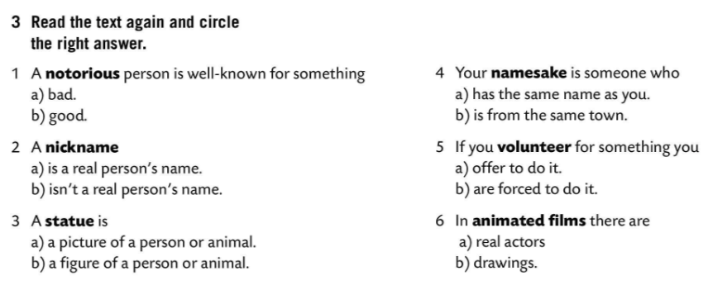
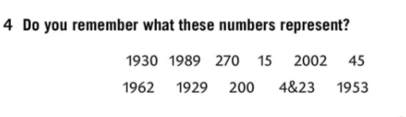
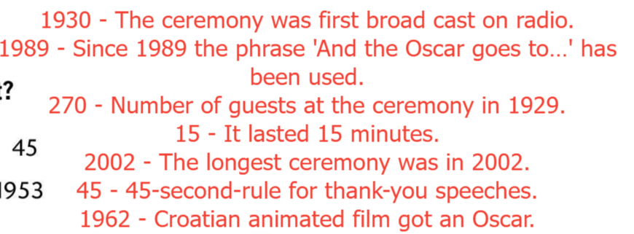
Read the text again. Are sentences in Task 2 true (T) or false (F)?
Check.
F
Read the text again and circle.
F
T
Check.
T
F
F
Do you remember these numbers?
T
T
Check.

Slide 8
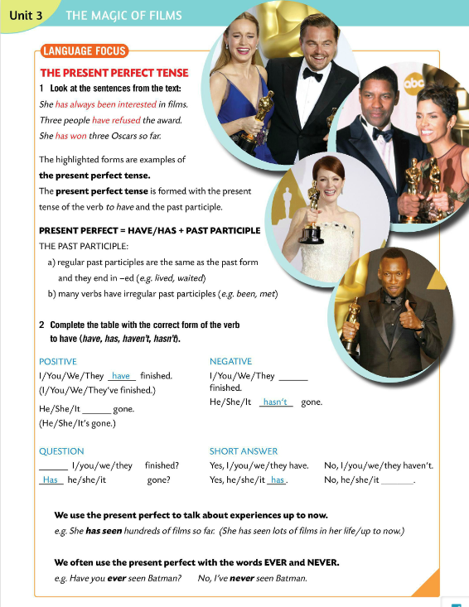
LANGUAGE FOCUS
THE PRESENT PERFECT TENSE
The present perfect tense is formed with the present tense of the verb to have and the past participle.
Glagolsko vrijeme present perfect tvori se od prezenta pomoćnog glagola ‘to have’ i past participle oblika glavnog glagola.
HAVE/HAS + PAST PARTICIPLE = PRESENT PERFECT

Slide 9
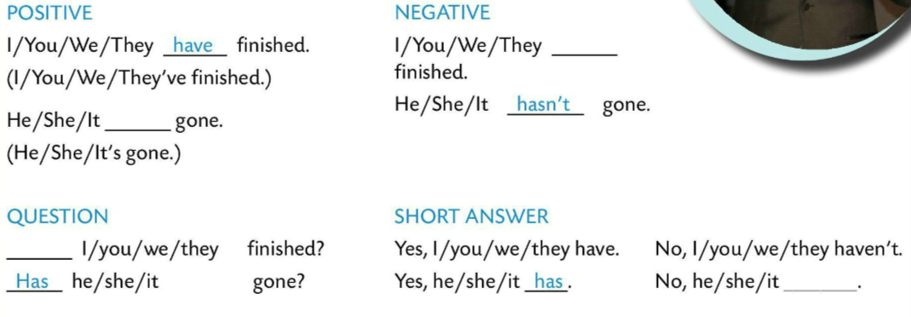
Regular past participles are the same as the past form. They end in –d or -ed.
Pravilni oblik glagola je jednostavan te se na glagol dodaje nastavak –d ili –ed.
e.g. lived, waited
watched, played
haven’t
Many verbs have irregular past participles.
Mnogi glagola ima nepravilan past participle oblik.
e.g. been, met
has
Have
hasn’t
Complete the table with the correct form of the verb to have (have, has, haven’t, hasn’t).
Check.

Slide 10
We use the present perfect to talk about experiences up to now.
Glagolsko vrijeme present perfect koristimo kada govorimo o iskustvima koje smo imali do trenutka u kojem govorimo.
e.g. She has seen hundreds of films so far. (She has seen lots of films in her life/up to now.)
We often use the present perfect with the words EVER and NEVER.
Glagolsko vrijeme present perfect često koristimo uz riječi EVER (ikada) i NEVER (nikada).
e.g. Have you EVER seen Batman?
No, I’ve NEVER seen Batman.

Slide 11
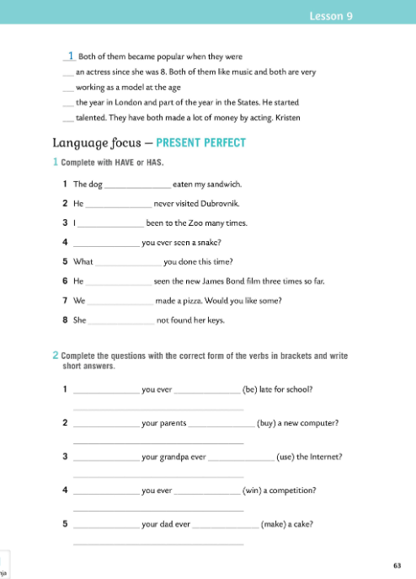

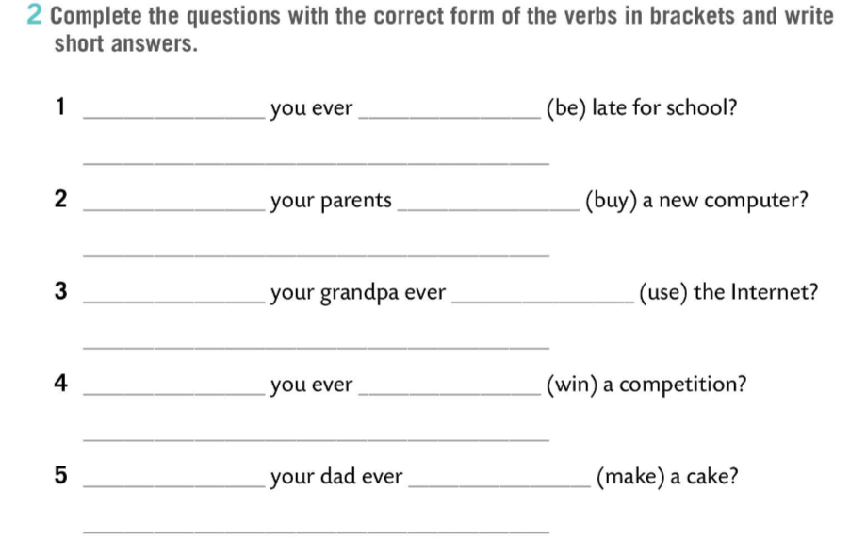
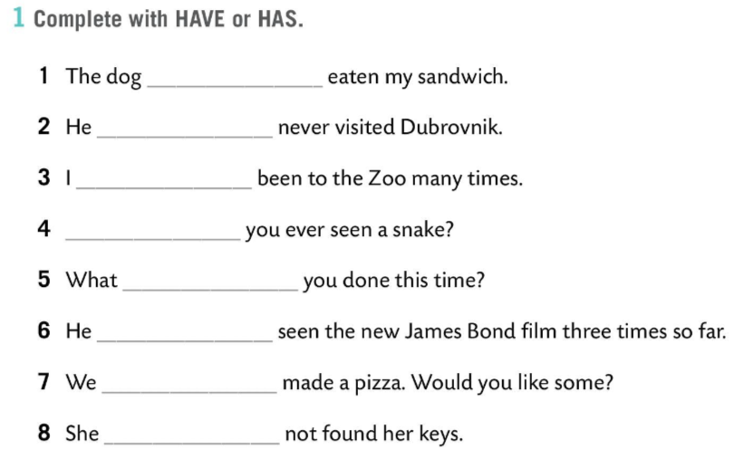
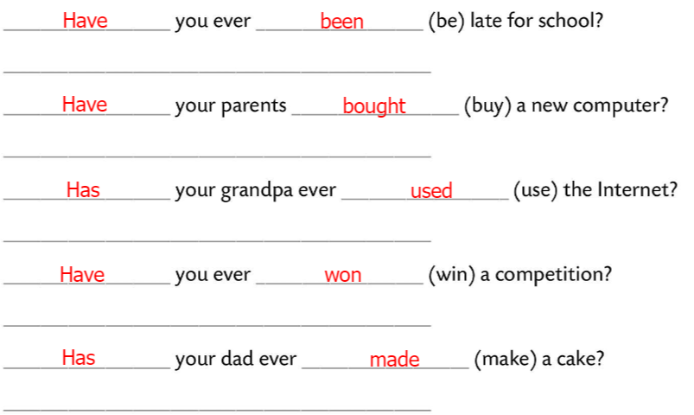
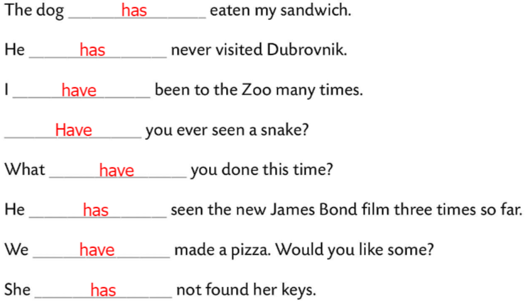
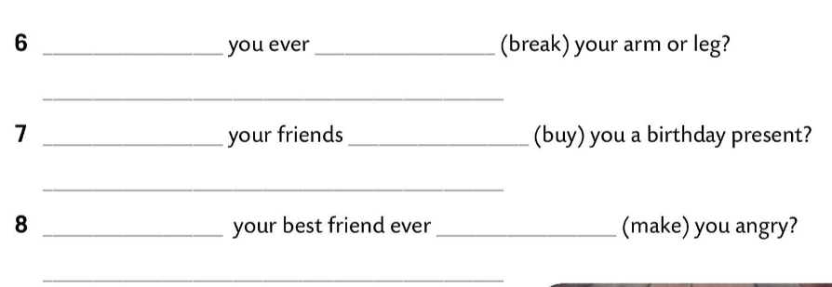
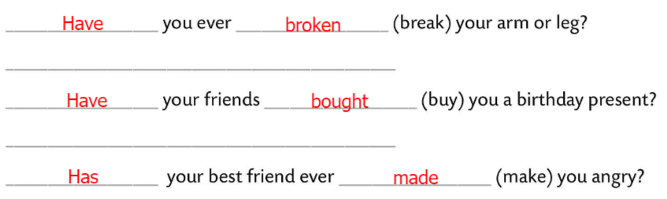
Workbook, page 63
Complete with HAVE or HAS.
Check.
Complete the questions with the correct form of the verbs in brackets and write short answers.
Check.

Slide 12
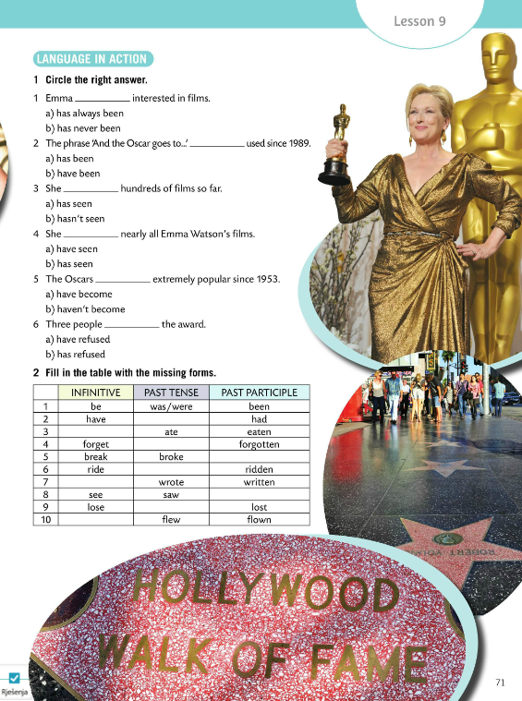
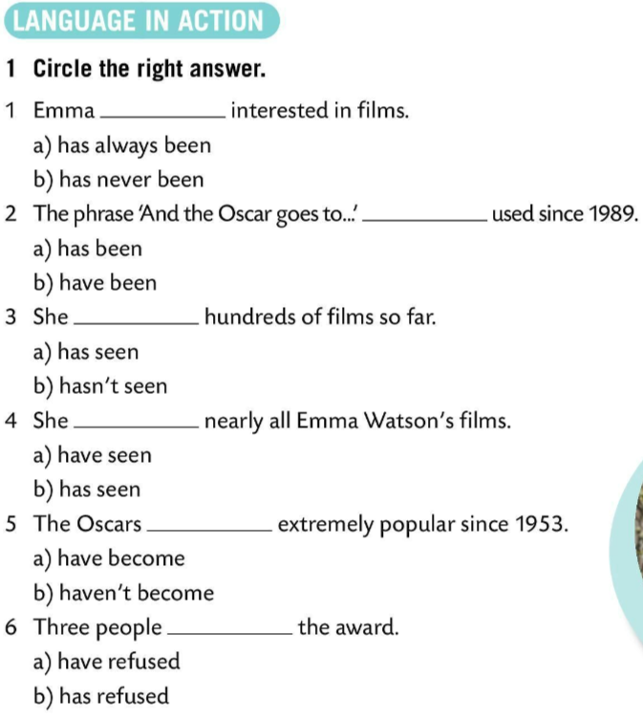
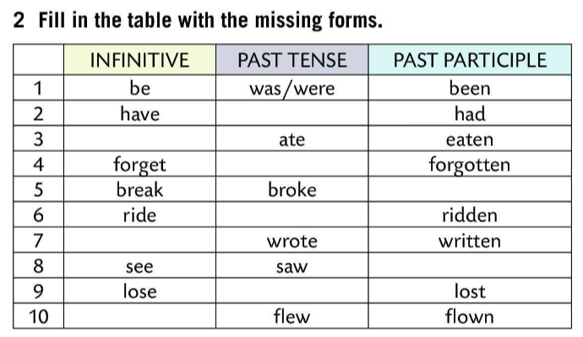
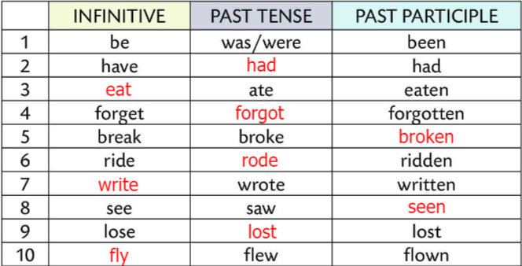
Circle the correct answer.
Check.
Fill in the table with the missing forms.
Check.
Drag and drop words into blank spaces within text.
https://wordwall.net/play/849/217/237

Slide 13
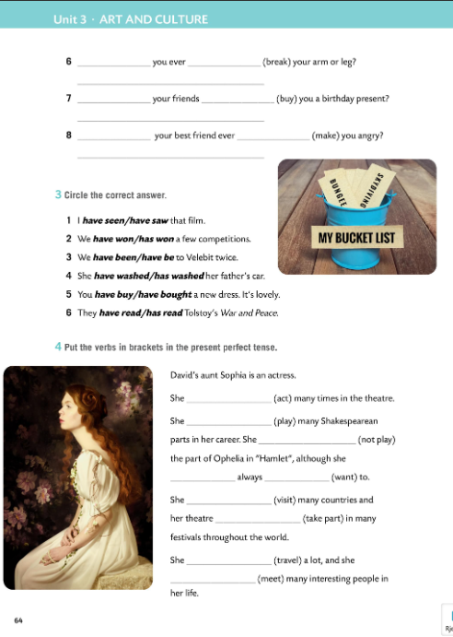
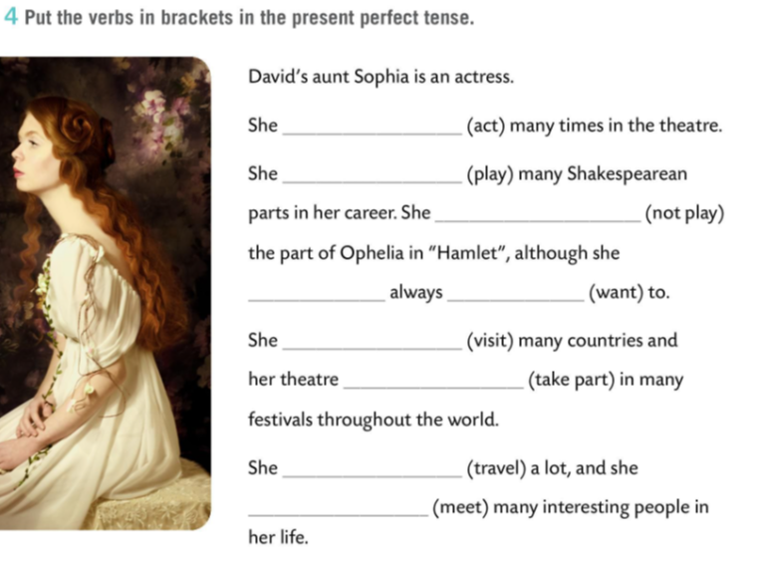
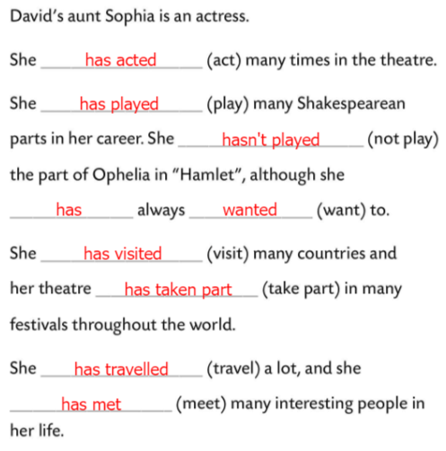
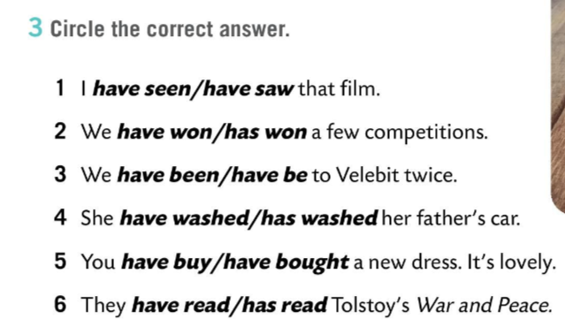
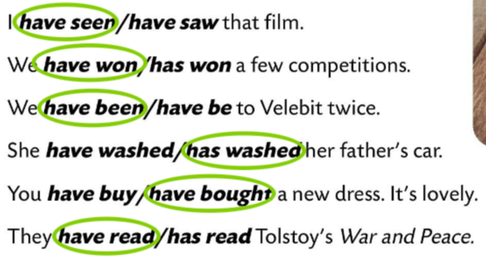
Workbook, page 64
Circle the correct answer.
Check.
Put the verbs in the brackets in the present perfect tense.
Check.

Slide 14
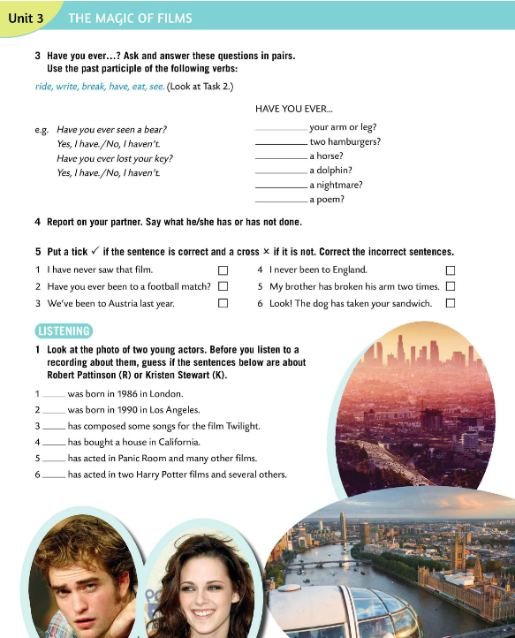
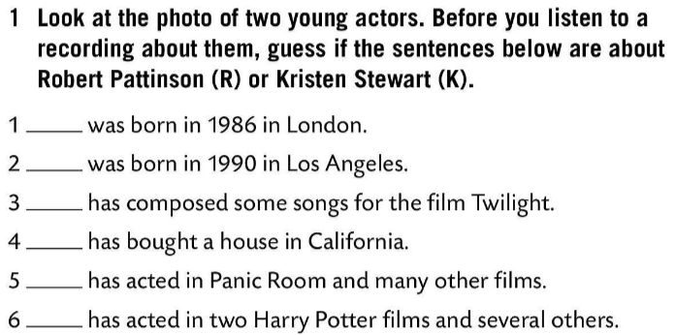
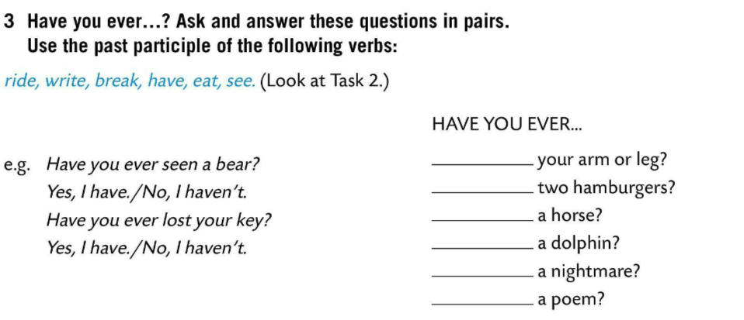
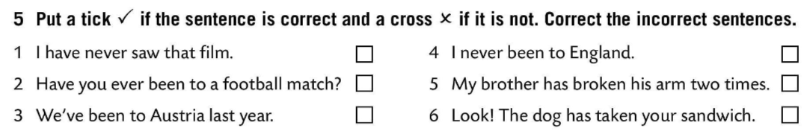

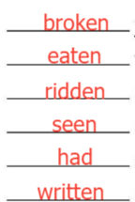

Have you ever…? Ask and answer questions in Task 3 in pairs. Use the past participle of the verbs. Look at the examples.
Check.
Report on your partner. Say what he/she has not done.
I have never seen that film.
I have never been to England.
Put a tick if the sentence is correct and a cross if it is not. Correct the incorrect sentences.
We’ve been to Austria.
Check.
Look at the photo of two young actors. Before you listen to a recording about them, guess if the sentences in Task 1 are about Robert Pattinson (R) or about Kristen Stewart (K).

Slide 15
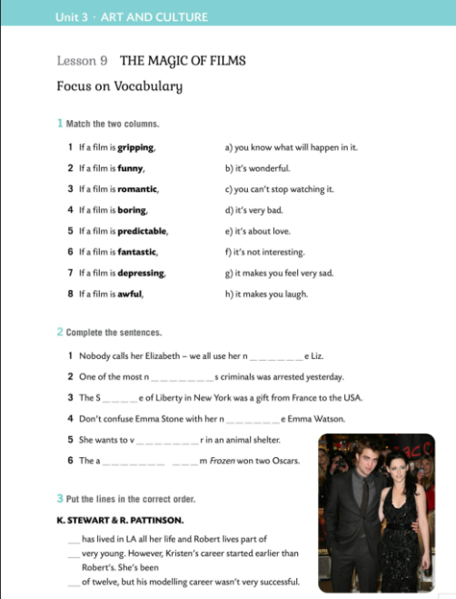
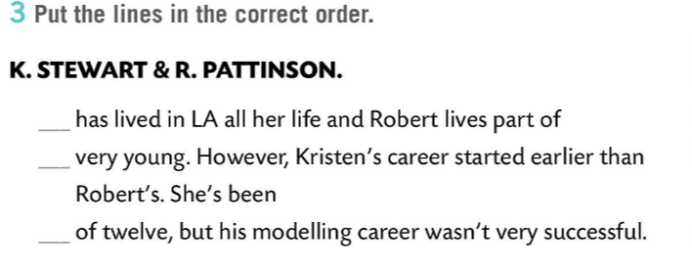
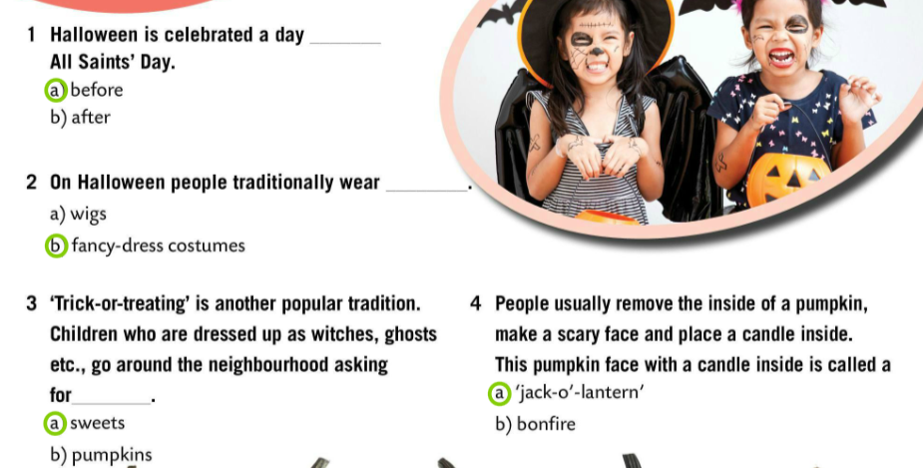
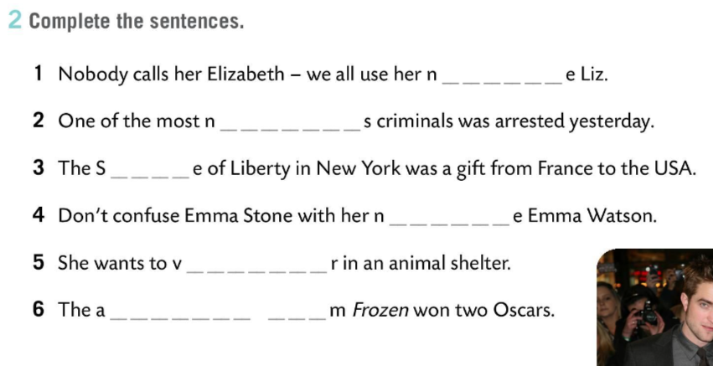

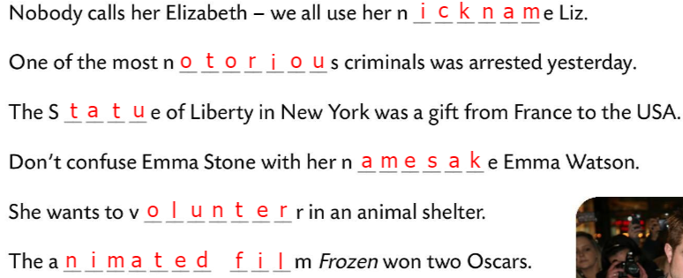

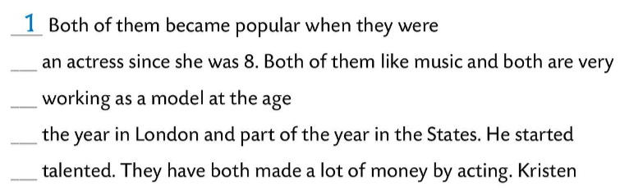

Workbook, page 62
Match the two columns.
Check.
Complete the sentences.
Check.
Put the lines in the correct order.
Check.

Slide 16
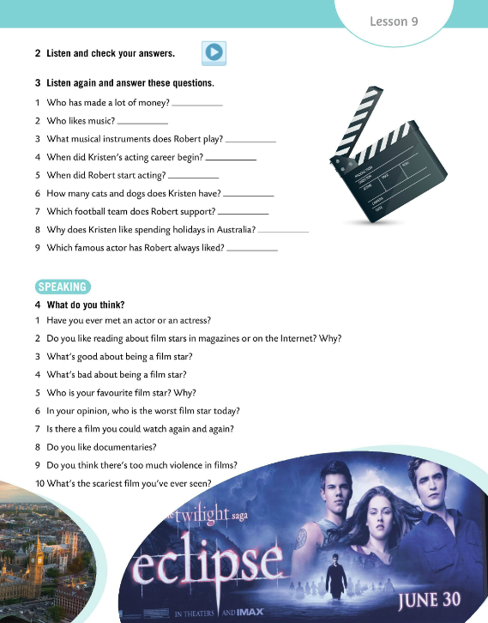




Listen and check your answers.
Check.
Listen again and answer the questions.
Kristen/both
Check.
both
He can play the guitar and the piano.
Her acting career started when she was 8.
Speaking time!
What do you think? Read the questions and express your opinion.
He started acting when he was 15.
She has 3 dogs and a cat.
Arsenal
Because her mother is Australian.
He always liked Jack Nicholson.

Slide 17




Read and listen to the dialogue.
Read the dialogue in pairs.
Match the expressions from the dialogue with their meaning.
Check.
3
4
2
Make a mini-dialogue with your partner.
Use at least one expression from Task 2.
1
Play this game and revise adjectives.
https://wordwall.net/play/849/163/356

Slide 18



Read Dino’s review of the film The Matrix and then write a short review of the film you like.
The questions below will help you.

Slide 19





Workbook, page 65
Look at the table and say what Dino and Ana HAVE or HAVEN’T done.
Put a tick or a cross for yourself and tell the class what you have or haven’t done.
Work in pairs. Ask questions about Dino and Ana. Your partner will look at the table and answer. Then, swap roles.
Complete the two mini dialogues in Task 6.
Check.

